Slide 1
BACTEREMIA
Shahbaz Hasan
3/7/24

Slide 2
A short history of detection of Bacteremia
Pre 1880 | Single drop of blood | To diagnose puerperal sepsis
1886 | Sterilizable syringe | Larger blood volumes can be drawn
Early 20th Century | Development of media and culture techniques | Labor intensive, cultures held for 2 weeks
1970s | BACTEC | First automated blood culture technology
1990s | BacT/Alert, BACTEC 9000 series, ESP, VITAL | Fully automated and continuous monitoring systems
Early 2000s | MALDITOF-MS:(Matrix-Assisted Laser Desorption Ionization Time of Flight-Mass Spectrometry) PCR based Identification systems | Speeds up detection and drug susceptibility
Post 2010 | Cell Free-DNA based: Karius | Rapid, direct sample from blood

Slide 3
Blood Culture Processing
Microbiology Laboratory Process
Step-by-Step, Laura Knolls

Slide 4
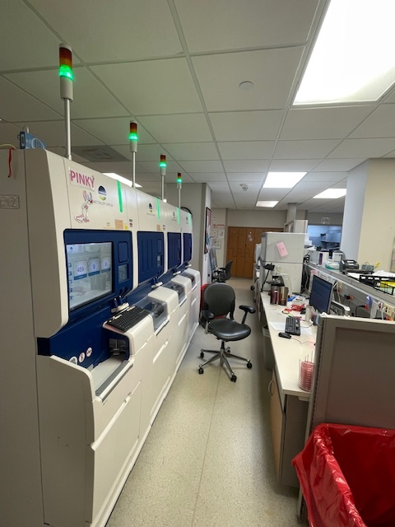
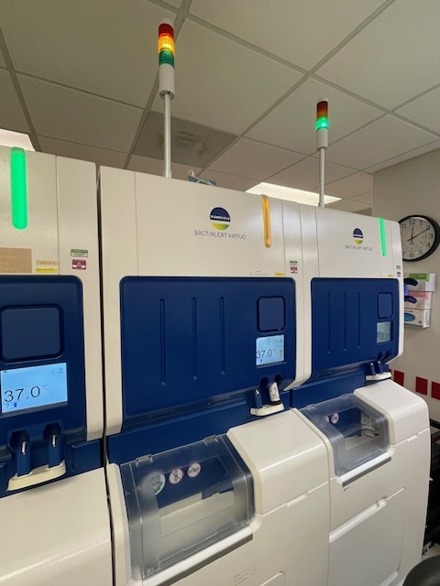
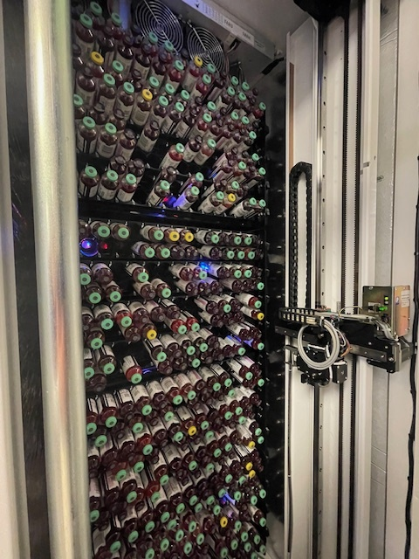
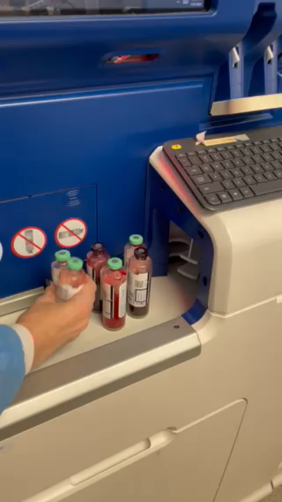
Bottles loaded onto automated monitoring system
Video - Loading Bottles
Virtuo Blood Culture System
Virtuo Blood Culture System
Inside Virtuo Unit

Slide 5
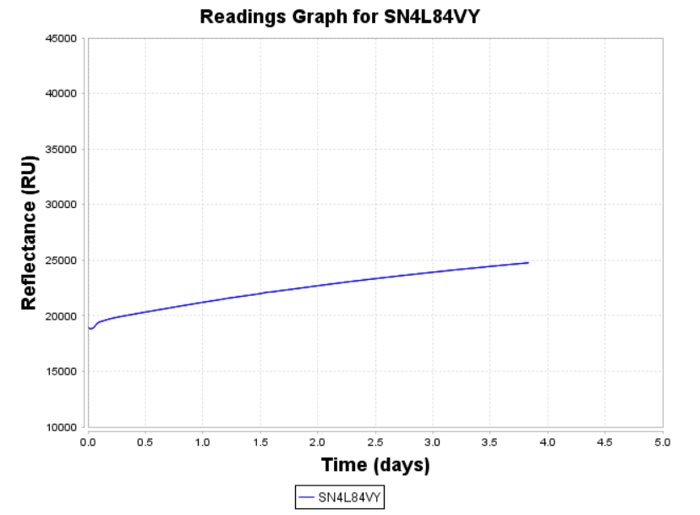
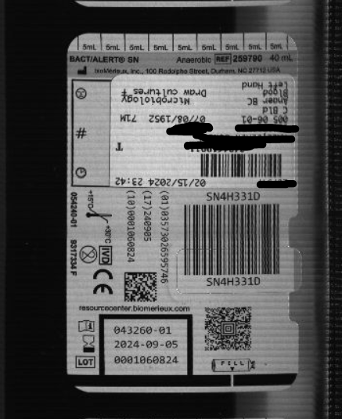
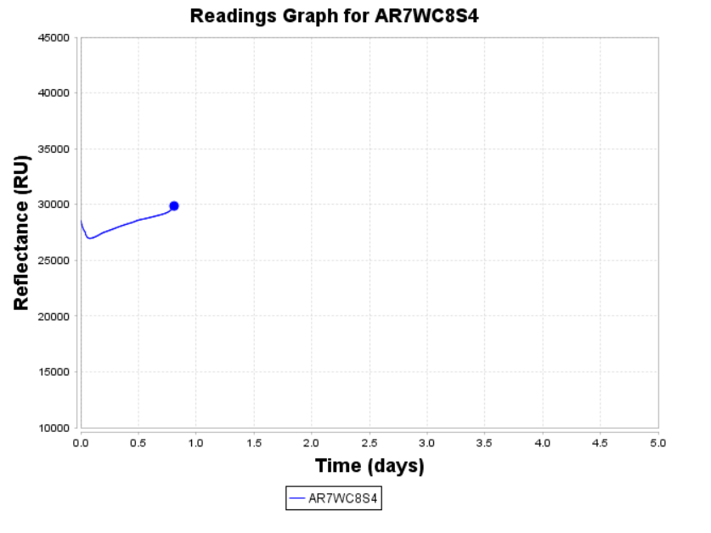
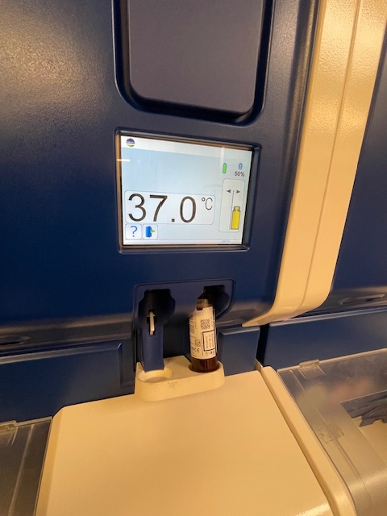
Bottles loaded onto automated monitoring system
Pic of bottle taken by instrument
Negative bottle
Instrument measures volume of blood in each bottle and takes a picture
Places into a cell for continuous monitoring for 5 days
Extended incubation time available upon request
Rising CO2 levels within the bottle are recognized through a series of sensor readings and plotted graphically.
Once the growth curve has been crosses a threshold, the bottle is determined to be positive, and the instrument alerts the technologist through visual and audible alarms.
Bottle is removed from its cell and sent to shoot for removal
Positive bottle and graph

Slide 6
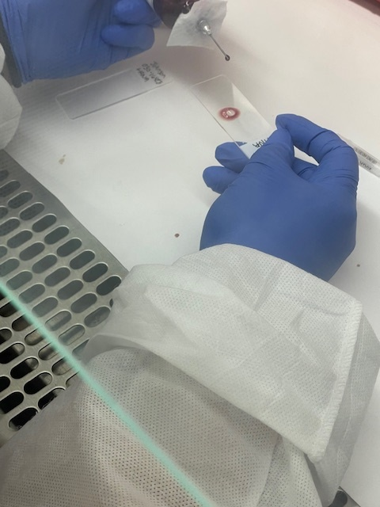
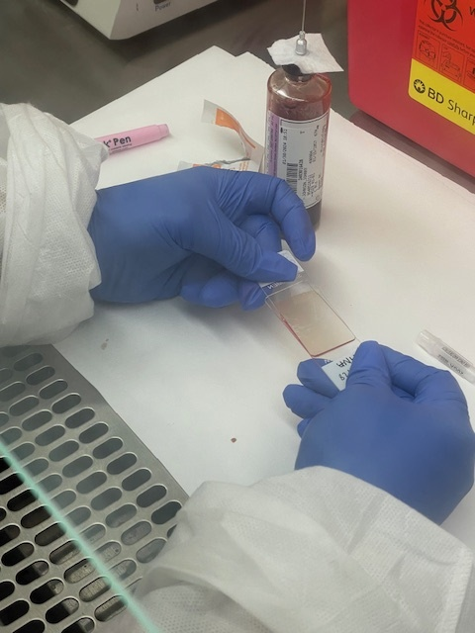
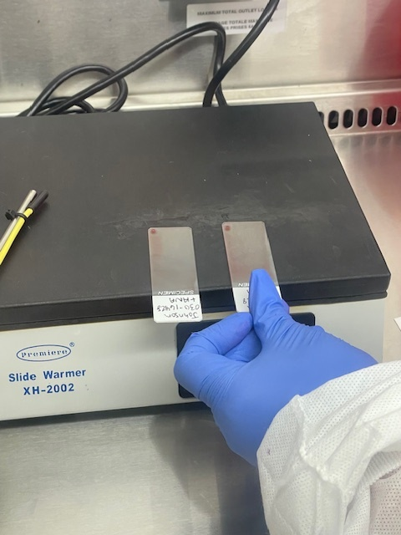
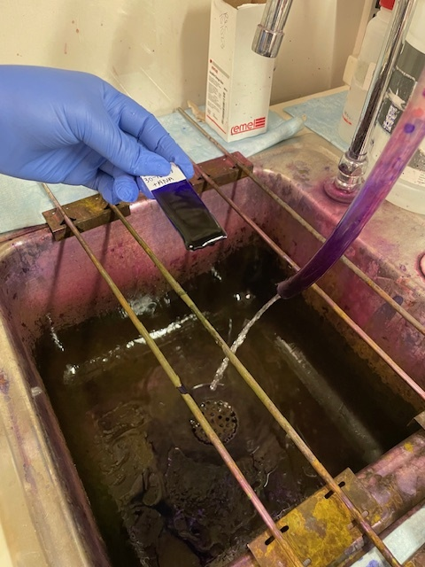
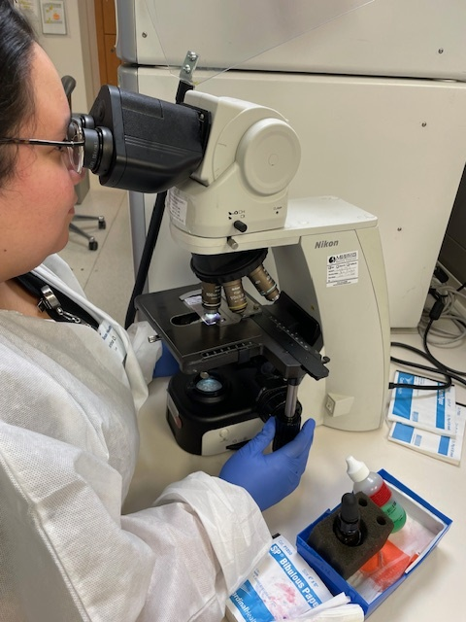
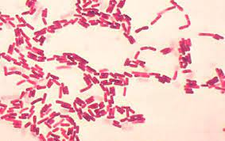
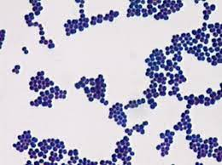
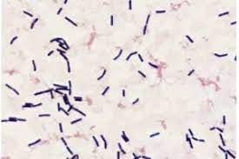
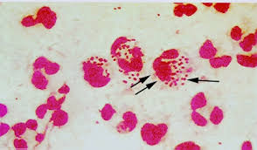
What’s in the Positive Bottle?
Microscopic Evaluation

Slide 7
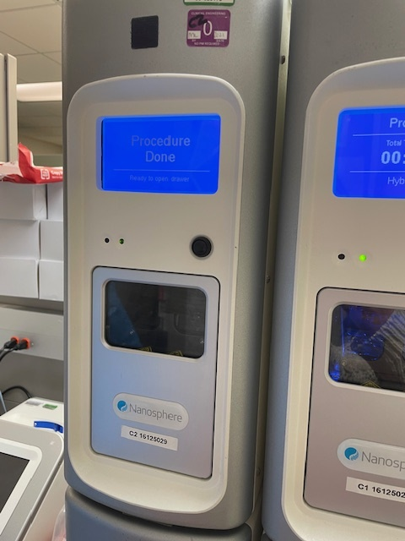
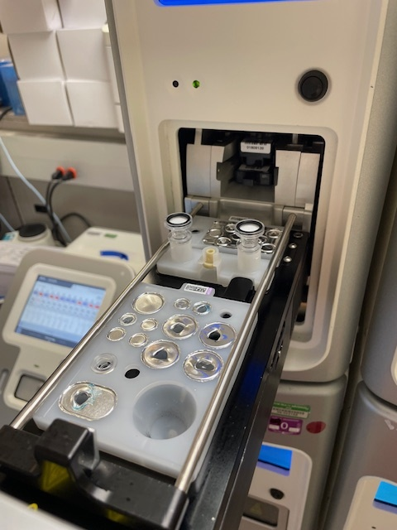
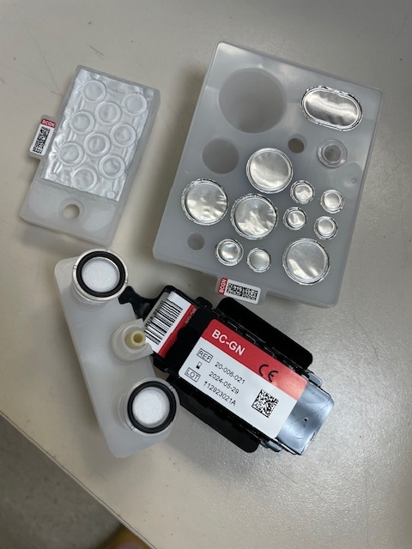
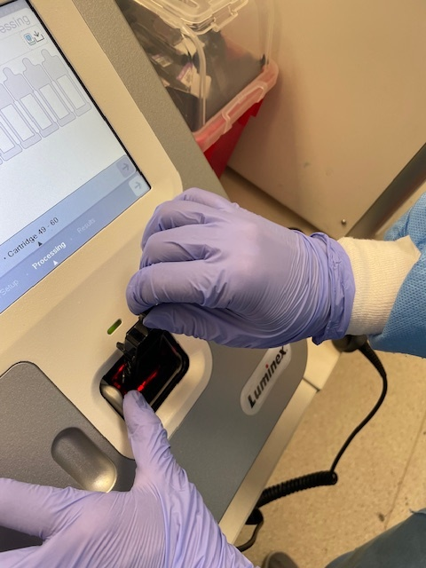
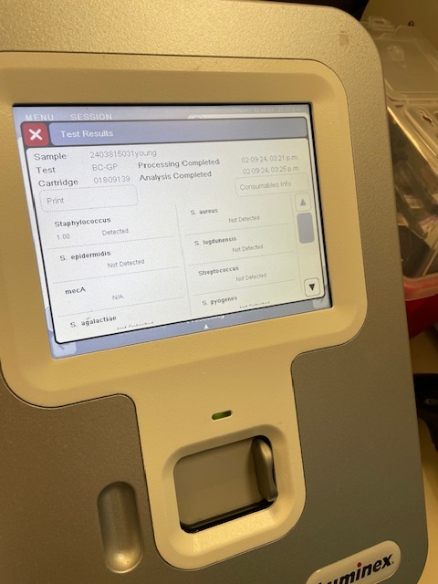
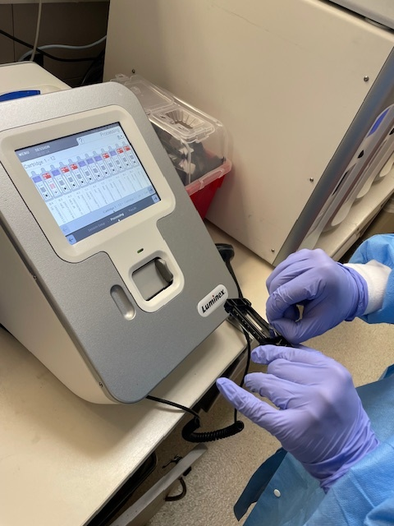
What’s in the Bottle? Rapid Molecular Identification (Verigene)
Gram Positive Cocci
12 targets + mecA, vanAB
Gram Negative Rods
8 targets + CTXM and carbapenemases
Uses gold nanoparticles for hybridization of bacterial target DNA (no amplication)
Place all required reagents on board with 350-700 µl of sample from bottle
Instrument will take 2-2.5 hours to process (TAT 4 hours from positive bottle alert)
The array chip located on the reaction slide is placed into a reader to evaluate the final result.

Slide 8
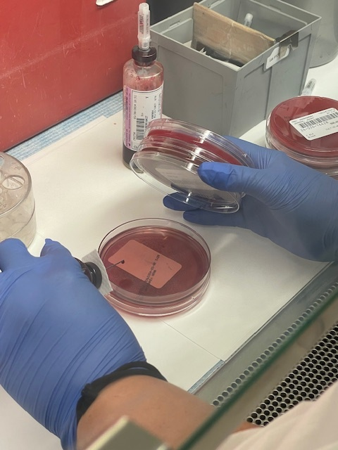
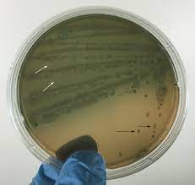
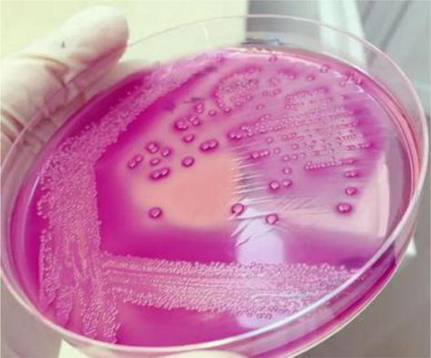
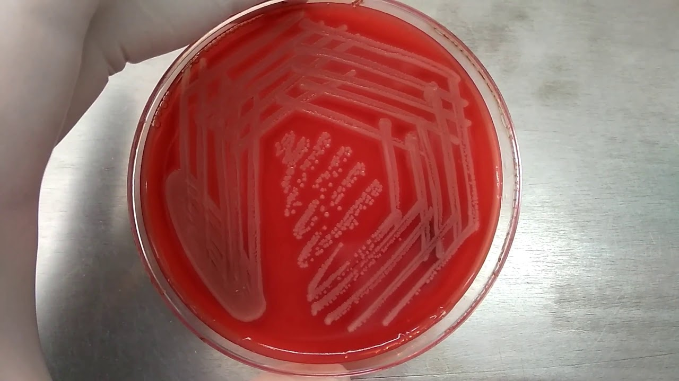
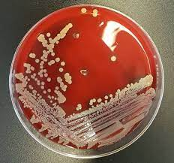
What’s in the Bottle? Culture
- Plates evaluated at 18 hours

Slide 9
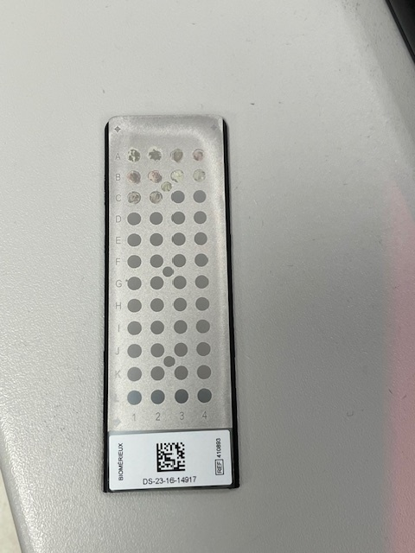
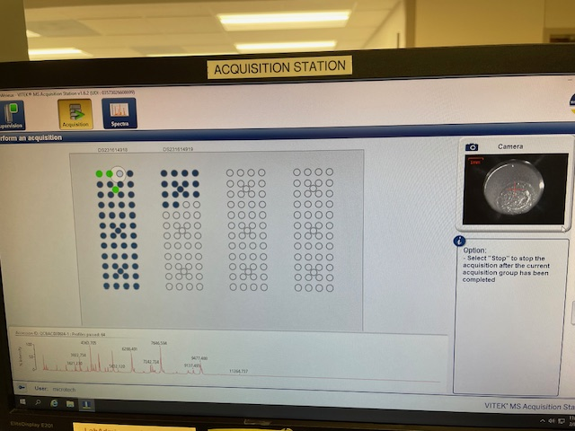
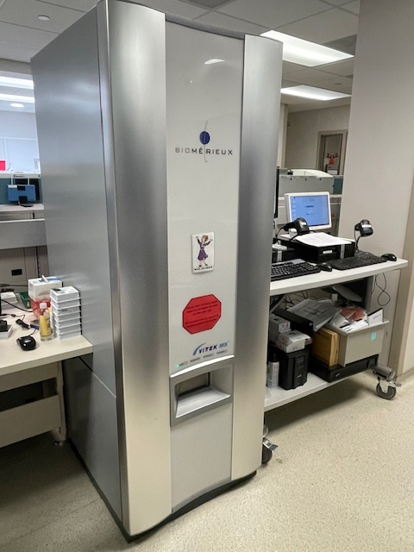
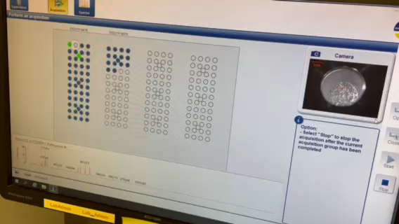
What’s in the Bottle? Identification from Culture– Vitek MS Maldi-TOF
Maldi-TOF Spectra
Results same day as initial plate read in most cases
Instrument reads each spot in less than 2 min
Maldi-TOF video

Slide 10
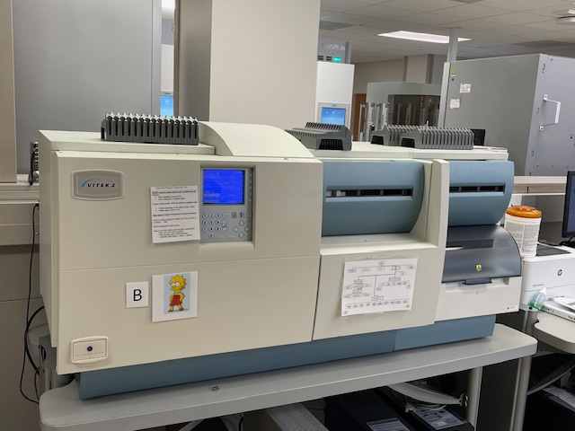
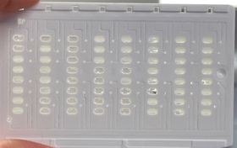
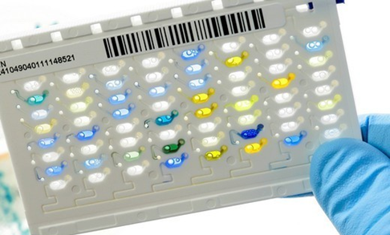
What’s in the Bottle? Automated Susceptibility Testing (Vitek)
AST card
Identifications and Susceptibility testing set same day as initial plate read in most cases – results 12-24 hours from time on board the Vitek
ID card

Slide 11
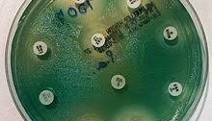
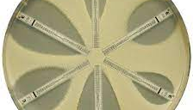
What’s in the Bottle? Manual AST
Used for MDR reflex testing or if organism does not qualify for automated AST (or fails on auto-AST)
TAT 18-24 hours after setup from culture plates

Slide 12
Blood Culture Collection
Continuous Monitoring System
Positive Growth Detected
PCR Based Technology
3-5 Days
2-3 Days
Gram Stain and Subculture
MALDITOF-MS
Final ID
Susceptibility Testing

Slide 13
Who needs a Blood Culture?
Incidence of Bacteremia in selected Clinical situation
Impact of detection of Bacteremia on Clinical management

Slide 14
Utility of Blood Cultures. Fabre V et al: CID2020:71(5);1339-7
YIELD | CLINICAL SITUATIONS | IMPACT on MANAGEMENT or PROGNOSIS
Very Low (<5%) | Isolated Fever; early postop fever | No
Low (< 10%) | Cellulitis; cystitis; nonsevere pneumonia | No
Low to Moderate (10-20%) | Severe Cellulitis; VAP | No
Moderate (20-50%) | Pyelonephritis; severe CAP, Cholangitis; liver abscess; Nonvascular shunts (eg VPS) | Yes: bacteremia associated with ICU mortality in VAP
High (>50%) | Septic shock, meningitis; endovascular infections; discitis; vertebral osteomyelitis; septic arthritis; epidural abscess | Yes

Slide 15
Rank Order of Bacteria causing BSI
M.I. Wilson: CMI 26(2020) 319-324
S. aureus
Other Enterobacteriaceae
E coli
Enterococus
Fungi
Coagulase Negative staphylococci
Streptococci
Anaerobic bacteria
Pseudomonas
Other Gram-Negative bacteria
Other Gram-Positive bacteria
Mycobacteria

Slide 16
A 36y WM presents with a large skin boil. He has fever and leucocytosis. The boil is lanced and he is started on IV Vancomycin. Blood culture grows MRSA within 12 hours. After 3 days, he has defervesced, but his repeat blood culture after 3 days is still growing MRSA
Is the bacteremia real?
Is this an Uncomplicated bacteremia?
Should he undergo an ECHO?
How long should he be treated?
Should we change vancomycin?
Can we switch to oral antibiotics?

Slide 17
S. aureus bacteremia
Common: 50 cases per 100,000
High mortality: 20-30%
High risk for endocarditis
High risk for metastatic disease
High risk for persistent bacteremia
MRSA accounts for about half of S aureus bacteremia

Slide 18
Complicated vs Uncomplicated Bacteremia: S aureus
Persistent bacteremia: > 72 hours to clear (down from > 7 days)
Endovascular infection: Prosthetic valves, intracardiac devices, IV grafts or lines, mycotic aneurysms
Delayed clinical improvement
Source control is not possible: retained devices, septic joints, osteomyelitis
Evidence of metastatic disease: brain, bones, joints, urine, lung
Obvious evidence of endocarditis

Slide 19
Principles of managing
S. aureus bacteremia
First categorize if Complicated or Uncomplicated
Document clearance of bacteremia: repeat Blood cultures every 48 hr
ECHO: TTE vs TEE
Image for metastatic disease: symptom directed: Brain, spine, joints
Source control: Removal of lines, I/D of abscesses and thrombophlebitis, debridement of bones, washout of joints, valve surgery and explant prosthetic materials
Followup blood cultures on completion of treatment

Slide 20
Treatment of S. aureus bacteremia
MSSA
1st generation cephalosporin (cefazolin) or antistaphylococcal PCN (nafcillin)
Oral step down: 1st gen cephalosporins (cephalexin) or PCN (dicloxacillin)
MRSA
Vancomycin: provided AUC/MIC of 400-600mg/h/lit can be achieved
Daptomycin +/- Beta-Lactam: "See-saw" effect
New 5th gen cephalosporins: Ceftaroline, Ceftobiprole: not approved for BSI
Long-acting glycopeptides: Dalbavancin, Oritavancin
Oral Step Down: Linezolid, combination Cipro/Rifampin

Slide 21
Duration of Treatment of S. aureus bacteremia
Uncomplicated:
2 weeks of IV antibiotics, timed from clearance of bacteremia
Complicated, but without endocarditis or osteomyelitis:
4 weeks of IV antibiotics
Complicated, but with endocarditis or osteomyelitis:
6 weeks of IV antibiotics

Slide 22
A 25y woman presents with pyelonephritis. Blood and urine culture grow Vancomycin Resistant E faecium. She is started on IV Daptomycin and rapidly defervesces with improvement in inflammatory markers.
How long should she be treated?
Does she need an ECHO?
Does she need followup blood cultures?
Can we switch to oral antibiotics?

Slide 23
Enterococcal Bacteremia
 | E faecalis | E faecium
Clinical BSI | 90% | 10%
Infective Endocarditis | 90% | 10%
Drug Resistance (VRE) | 10% | 90%
Source | Genitourinary, GI | GU, GI, catheters, polymicrobial

Slide 24
Risk Stratification of Enterococcal BSI
DENOVA: >3 increases risk for endocarditis
Duration of symptoms, > 7d
Embolization
Number of positive blood cultures
Origin: unknown source
Valve disease
Auscultatory findings: murmur
General Rules of Treatment:
Uncomplicated: 7-14 days of treatment, single agent. For VRE, 14d after clearance
Complicated: 4-6 weeks, often combination treatment

Slide 25
Treatment of Enterococcal Bacteremia
 | E. faecalis | Vanc sen E. faecium | VRE
UNCOMPLICATED | Ampicillin or PenG Vancomycin Daptomycin Linezolid | Vancomycin Daptomycin Linezolid | Daptomycin or Linezolid Daptomycin + Betalactam
COMPLICATED | Amp + Rocephin Amp + Gentamicin Vancomycin + Gentamicin Dapto + Betalactam | Vanc + Gent Dapto + Gent Dapto + Betalactam Linezolid | Dapto or Linezolid + either Gent or a Betalactam

Slide 26
A 62y man presents with acute cholecystitis. Blood culture grows E coli. He undergoes a laparoscopic cholecystectomy. No necrosis or perforation was noted. He is started on IV Rocephin
How long does he need to be treated?
Does he need an ECHO?
Can he be switched to oral antibiotics? When?
Does he need follow up blood culture to document clearance?

Slide 27
Gram Negative Bacteremia
Frequent
Increasing issues of antimicrobial resistance: ESBL, CRE, MDRO
High mortality
Associated with increased lengths of stay, antibiotic use, investigations and overall cost

Slide 28
Main Types of Gram Negative Bacteremia
 | Bacteria | Source
Commensal GI | E coli; klebsiella; proteus | Gut, genitourinary, IV lines, IVDA, wounds | Rapid response to antibiotics and source control
Non-Commensal GI | Salmonella; Shigella; Brucella | Feco-oral; animal contact | Gastroenteritis; Enteric Fever
Commensal Oral and Respiratory tract | H influenza; Moraxella; HACEK; N meningitidis | Upper/Lower RTI; dental; meningitis | Rapid response to antibiotics
Environment/Nosocomial | Pseudomonas, Acinetobacter, Enterobacter, Serratia, Morganella, Providencia, Citrobacter | Gut; Genitourinary; Wounds; IV lines; IVDA; Ventilator Assoc pneumonia; | High risk for Drug Resistance; High morbidity and mortality
Anaerobes | Bacteroides; Prevotella, Fusobacterium | Oral/Dental; Lower GI; PID; Wounds and Osteo | Rapid response to antibiotics

Slide 29
An elderly W with dementia is sent from her Nursing Home due to lethargy. She is afebrile, normal WBC, and is noted to have a cystitis. She responds to IV fluids and oral antibiotics. She is ready for dischage but you are notified that her blood culture drawn in the ER 2 days ago is now growing S. hominis in 2 of 2 sets. What should you do?
Hold discharge, repeat blood culture and begin vancomycin?
Order an ECHO?
Discharge back to Nursing Home? No further action?
Call ID?

Slide 30
Blood Culture Contaminants: The Cost
Over 30 million Blood cultures are drawn yearly
Contaminants are common. Target should be less than 3%. Now < 1%
Cost estimate of Contaminant:
$3000-8000 per contaminant
Increased Length of Stay of 1-8 days
Over $ 1 Billion per year
Increased Lab Utilization: Direct Tech workload, Increased cost of testing, Negative Trust issues
Increased Clinical Costs: unnecessary antibiotic use, unnecessary tests and imaging, increased length of stay, unnecessary removal of lines/devices, increased complications of antibiotics, unnecessay ID Consult

Slide 31
Bacteriology of Contaminants
 | BACTERIA
USUALLY | CoNS, Corynebacteria, Bacillus, Micrococcus, Cutibacterium
SOMETIMES | Enterococci, viridans Streptococci, Clostridium
NEVER | S. aureus, Gram Negs, S. lugdunensis, Beta Hemolytic Streptococci, S pneumoniae, Yeast

Slide 32
Prevention of Contaminants:
All about Technique of Sample collection
Pretest Probability impacts Post Test predictive value: Choose wisely
Skin Disinfection: 0.5% Chlorhexidine followed by Alcohol. Allow dry
Disinfect Bottle Top: 70% isopropyl Alcohol
Draw from vein, not from IV apparatus: Two different sites, 15-20 minutes apart
Sterile Gloves and Hand hygiene
Appropriate volume of blood: 8-10 ml per bottle
Use of Phlebotomist Teams
Surveillance and Feedback for Quality Improvement
Initial Blood Specimen Diversion Systems:
  Steripath Generation 2: removes initial 1 ml or blood sample
  Kurian Lock Device: removes initial 0.15 ml of blood sample

Slide 33
Changing to Oral Antibiotics: Considerations
What is the risk of relapse: mainly issue with Complicated Gram Positive (S aureus and Enterococcus) bacteremia
Is there an appropriate oral antibiotic: high bioavailable, achieves good blood levels with respect to MIC of bacteria
Is the patient showing clinical improvement: fever, inflammatory markers, sepsis resolution
Does the patient have reliable oral intake: ileus or obstruction, vomiting, NG suction, dysphagia

Slide 34
IV to Oral Switch: Gram Positives
Uncomplicated:
Staphylococcus aureus: generally, 2 weeks of IV recommended. Some data for oral linezolid after 3-9d of IV antibiotics.
Streptococcus and Enterococcus: Change to oral after 4 days of IV
Complicated:
Pure Right sided endocarditis: 10-14 days of IV, then oral
Osteomyelitis: 14 days of IV, then oral. Some data suggesting oral from the start

Slide 35
IV to Oral switch: Gram Negatives
Most Uncomplicated Gram-negative bacteremia can be changed from IV to Oral after 72 hours.

Slide 36
Endocarditis Risk: Gram Positive Bacteremia
S. mutans
Abiotrophia
Frequency of IE
S. sanguinis
E. faecalis
S. gallolyticus
S. aureus
S. lugdunensis
S. mitis
S. agalactiae (GBS)
S. salivarius, S. anginosus, S. dysgalactiae, E. faecium, S. pneumoniae, S. Pyogenes (GAS)
CoNS
Frequency of Bacteremia
Rasmussen M et al, Clinical Microbiology and Infection. https://doi.org/10.1016/j.cmi.2023.08.027

Slide 37
Risk Factors for Endocarditis
High risk bacteria
Monomicrobial bacteremia
High grade bacteremia: multiple positive
Persistent bacteremia: positive despite appropriate antibiotics
Short time to positivity: < 10-14 hours
Community acquired infection
No obvious source of infection
Evidence of embolization or S/S of endocarditis
Longer duration of symptoms
Previous endocarditis
Prosthetic Heart Valve or Intracardiac device
IVDA

Slide 38
TTE vs TEE
TTE:
  Sensitivity/Spec 70%/90%; Drops considerably for Prosthetic valves
  If TTE is negative but of Good quality, with a low Pre-Test probability of endocarditis, and no overt signs of endocarditis, Then No Need for a TEE
TEE:
  Sensitivity for PVE and Intracardiac devices is 90%
  If TTE is negative, but there is a High Pretest probability of endocarditis, proceed to TEE
  If TEE is negative, but there remains a suspicion for endocarditis, then repeat the TEE in 5-7 days, or consider a PET scan.

Slide 39
Follow-up Blood Cultures
Advantages:
  Pick up a case of endocarditis
  Duration of Treatment may be based on clearance of bacteremia
  Documentation of clearance of bacteremia
Disadvantages:
  Pick up more false positive contaminants
Consider: high risk of persistence or endocarditis: S aureus, Candida, E faecalis
Not needed:
  Gram neg, Viridans strep, betahemolytic strep, pneumococcus
  Most cases of pneumonia, pyelonephritis, SSTI, uncomplicated GI infections

Slide 40
Are Follow-up Blood cultures needed for Gram Negative Bacteremia?
Generally, NO
Would consider in High Risk situations:
  Endocarditis
  Endovascular infections
  Vertebral osteo or Epidural Abscesses
  High grade bacteremia with inadequate source control
  Bacteremia involving MDRO Gram Negative

Slide 41
A 36y WM presents with a large skin boil. He has fever and leucocytosis. The boil is lanced and he is started on IV Vancomycin. Blood culture grows MRSA within 12 hours. After 3 days, he has defervesced, but his repeat blood culture is still growing MRSA
Is the bacteremia real?
Is this an Uncomplicated bacteremia?
Should he undergo an ECHO?
How long should he be treated?
Should we change vancomycin?
Can we switch to oral antibiotics?

Slide 42
A 25y woman presents with pyelonephritis. Blood and urine culture grow Vancomycin Resistant E faecium. She is started on IV Daptomycin and rapidly defervesces with improvement in inflammatory markers.
How long should she be treated?
Does she need an ECHO?
Does she need followup blood cultures?
Can we switch to oral antibiotics?

Slide 43
A 62y man presents with acute cholecystitis. Blood culture grows E coli. He undergoes a laparoscopic cholecystectomy. No necrosis or perforation was noted. He is started on IV Rocephin
How long does he need to be treated?
Does he need an ECHO?
Can he be switched to oral antibiotics? When?
Does he need followup blood culture to document clearance?

Slide 44
A elderly W with dementia is sent from her Nursing Home due to lethargy. She is afebrile, normal WBC, and is noted to have a cystitis. She responds to IV fluids and oral antibiotics. She is ready for dischage but you are notified that her blood culture drawn in the ER 2 days ago is now growing S. hominis in 2 of 2 sets. What should you do?
Hold discharge, repeat blood culture and begin vancomycin?
Order an ECHO?
Discharge back to Nursing Home? No further action?
Call ID?

